Slide 1


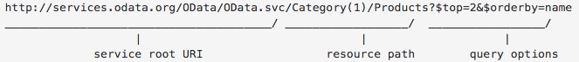
ODATA
$filter=: Returns only entities that match the specified expression. …/Products/?$filter=CategoryID eq 435
$orderby=: Orders results, in ascending or descending order, by the value of one or more properties in those results. …/Products/?$orderby=Name desc
$select=: Returns only the specified properties in an entity. …/Products?$select=Price,Name
$inlinecount=: Returns the total number of rows that match the $filter criteria. Useful for paging in combination with $top and $skip …/Products?$inlinecount=allpages
$top=n: Returns only the first n entities in an entity set (or in Atom terms, the first n entries in a feed). …/Products/?$top=2
$skip=n: Skips the first n entities in an entity set. Using this option lets a client retrieve a series of distinct pages on subsequent requests. …/Products?$skip=2
Source: https://www.odata.org/documentation/odata-version-2-0/uri-conventions/
Notes:
OData is an open-source protocol for serving and consuming interoperable data via Representational State Transfer (REST)-full APIs using everyday query operations - create, read, update, and delete (CRUD). In addition, OData uses web technologies like HTTP and JavaScript Object Notation (JSON) to access data from various entities. Moreover, D365FO exposes all its public data entities as OData endpoints which can then be accessed using the following URI format:
Service endpoint: [Your organization's root URL]/data/
The root service endpoint for OData entities
Example: https://<d365fourl>/data/Customers
OData is a fast, codeless data integration method with various query options and CRUD operations. You can query your data with its open standard query string language and manipulate it with standard OData CRUD commands, all with straightforward standard REST calls. In addition, if you want to call a custom method within your data entity, you can do so by exposing custom actions with your OData entities, which allows you to extend the commands to a certain extent.

Slide 2
ODATA Filter Operations
Operator |  |  | Example
eq | Equal | /Suppliers?$filter=Address/City eq 'Redmond' | /Suppliers?$filter=Address/City eq 'Redmond'
ne | Not equal | /Suppliers?$filter=Address/City ne 'London' | /Suppliers?$filter=Address/City ne 'London'
gt | Greater than | /Products?$filter=Price gt 20 | /Products?$filter=Price gt 20
ge | Greater than or equal | /Products?$filter=Price ge 10 | /Products?$filter=Price ge 10
lt | Less than | /Products?$filter=Price lt 20 | /Products?$filter=Price lt 20
le | Less than or equal | /Products?$filter=Price le 100 | /Products?$filter=Price le 100
and | Logical and | /Orders?$filter=OrderDate ge datetime'2021-01-01T00:00:00' and OrderDate lt datetime'2021-02-01T00:00:00' | /Orders?$filter=OrderDate ge datetime'2021-01-01T00:00:00' and OrderDate lt datetime'2021-02-01T00:00:00'
or | Logical or | /Products?$filter=Price le 3.5 or Price gt 200 | /Products?$filter=Price le 3.5 or Price gt 200
not | Logical negation | /Products?$filter=not endswith(Description,'milk') | /Products?$filter=not endswith(Description,'milk')

Slide 3
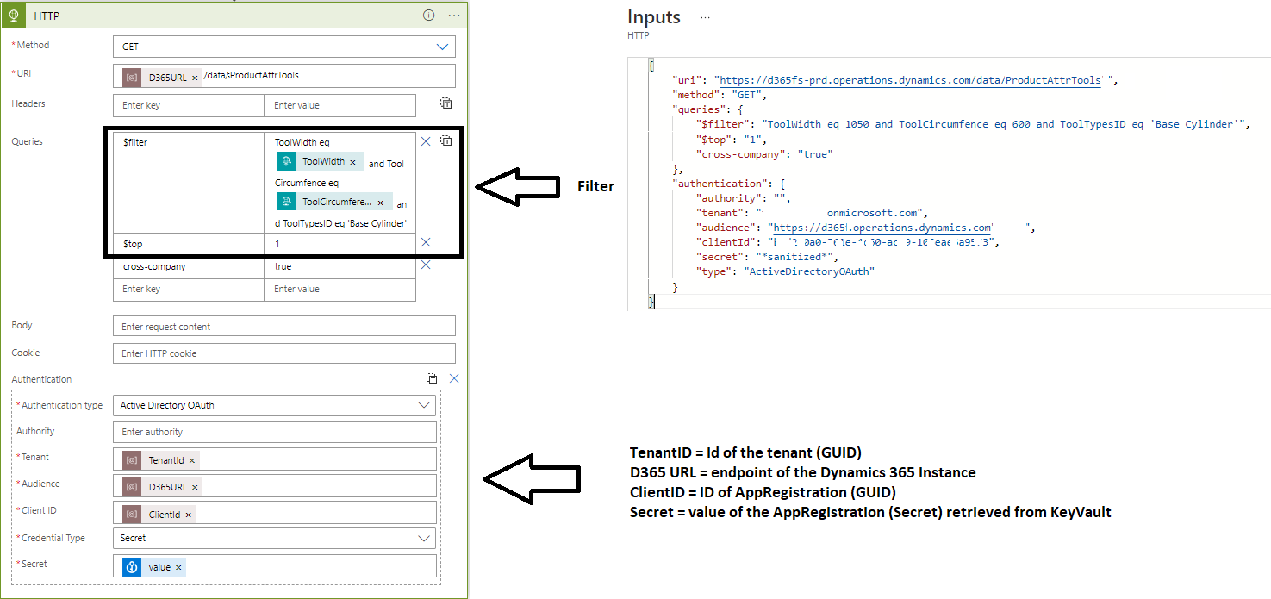
ODATA Call HTTP Connector
Notes:
The operation is a GET (read) of an entity in D365. With the HTTP connector, you can specify the Method, URI (endpoint), filter expression, the number of records you want to be returned (top), cross-company flag, and authentication type.
The HTTP connector will send the request to the endpoint (URI), including authentication (token retrieved from Azure Active Directory using the client id and secret) when you run the action.

Slide 4
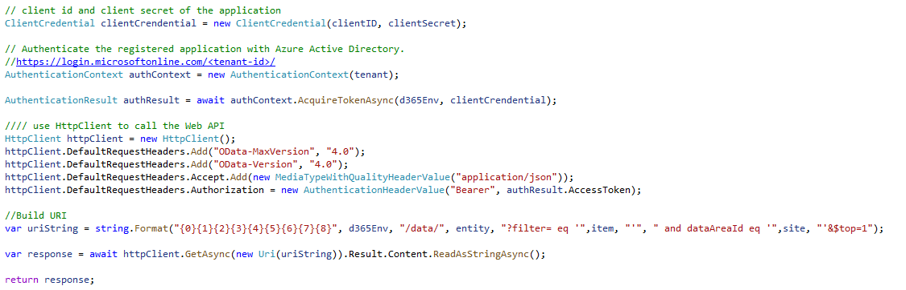
ODATA Call Azure Function

